Slide 1
Optical Ray Tracing
Motivation | Repetition
Single Lens | Arrays
Pointers | Records
Conditional | Files

Slide 2
Optical Ray Tracing
Handling Multiple Lens
Adding a Coordinate System

Slide 3
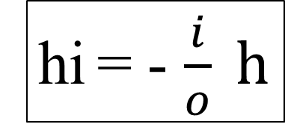
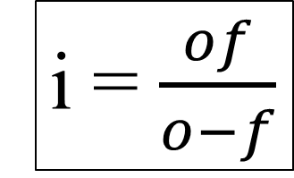

Single Lens Equations
Input
o, f, h
h
i = $\frac{of}{o−f}$
hi
i = $\frac{(of)}{(o−f)}$
ih=-(i/o)h
f f
hi = - $\frac{i}{o} h$
o i
Output
i,ih

Slide 4


Multiple Lens?
Code works for 1(one) lens but, if more than one lens,
it is difficult to keep track of distances.
Input
o, f, h
Solution: A coordinate system
i = $\frac{(of)}{(o−f)}$
ih=-(i/o)h
Output
i, ih
x0 x1 x2 x3?
-2 0 4 ?

Slide 5
Preparing for Multiple Lens
Solution: A coordinate system
Input
o, f, h
i = $\frac{(of)}{(o−f)}$
x_{i}
_{o}
h_{o}
+i
ih=-(i/o)h
+f
Output
i, ih
+o
x_{o}
x_{l}
h_{i}
o=xl-xo
xi = xl + i

Slide 6

Adding Coordinate System
Input
xo, h
h_{o}
+i
Input
h, o
+f
x_{o}
+o
x_{l}
x_{i}
Input
f
h_{i}
Input Lens
xl, f
o =xl-xo
o=xl-xo
xi = xl + i
i = $\frac{(of)}{(o−f)}$
xi=xl+i
hi=-(i/o)h
Output
xi, hi

Slide 7
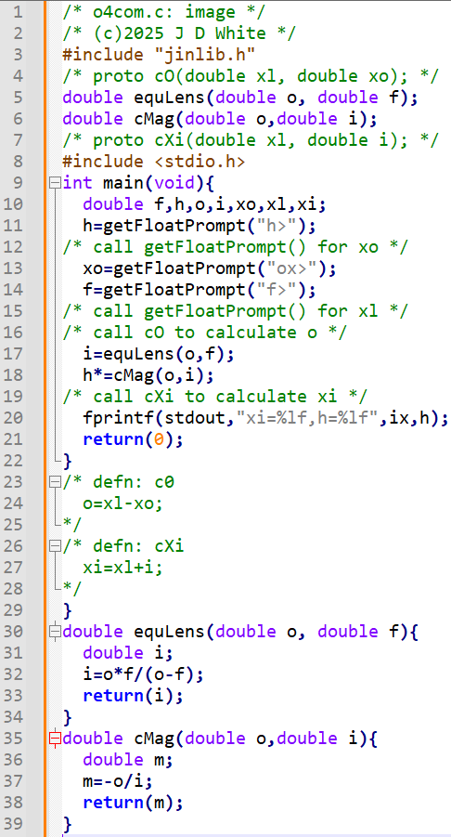
UML → Pseudo-Code
→ Write Pseudo Code

Slide 8
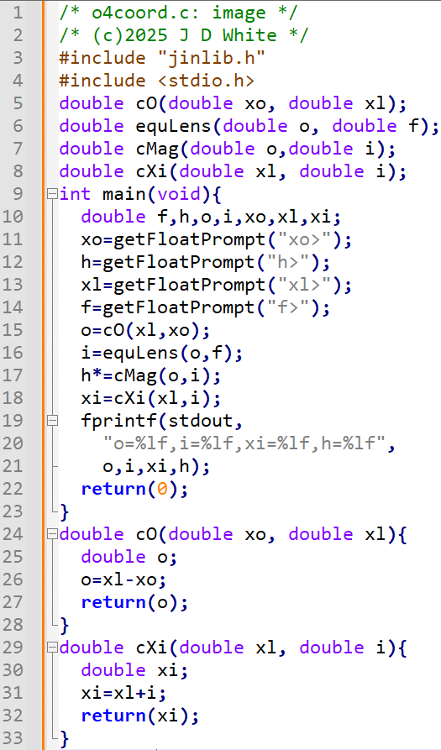
Pseudo-Code → C
→ Write ANSI-C Code

Slide 9
Run C Code
gcc –c –Wall -g o4bcoord.c
gcc –o b.exe o4coord.o jinlib.o
b
→ Run Code (gdb?)

Slide 10
Coordinate System Code Analysis
To Programmer: Introduction to this program
To Pre-processor: Location of function prototypes (standard & others)
To Compiler: Function Prototypes (my own, this file)

Slide 11
Coordinate System Code Analysis
0.0e0
0.1e1
0.2e1
0.5e1
getFloatPrompt()

Slide 12
Coordinate System Code Analysis
cO()
xo
0.0e0
0.1e1
0.0e1
xl
0.2e1
0.5e1
0.2e1
o
0.2e1
0.2e1

Slide 13
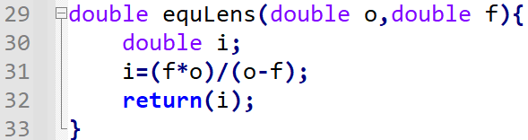
Coordinate System Code Analysis
equLens()
o
0.0e0
0.1e1
0.2e1
f
0.2e1
0.5e1
0.5e1
i
-0.33e1
0.2e1
-0.33e1

Slide 14
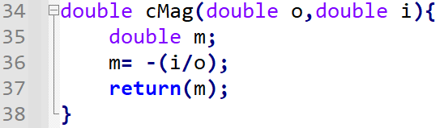
Coordinate System Code Analysis
cMag()
o
-0.165e1
0.2e1
0.0e0
0.1e1
i
0.2e1
0.5e1
-0.33e1
m
0.2e1
-0.165e1
-0.33e1

Slide 15
Coordinate System Code Analysis
cXi()
o
0.0e1
-0.165e1
0.2e1
i
0.2e1
0.5e1
-0.33e1
-0.13e1
0.2e1
xi
-0.13e1
-0.33e1

Slide 16
Coordinate System Code Analysis
0.0e1
-0.165e1
0.2e1
0.5e1
-0.13e1
0.2e1
-0.33e1
0
fprintf()
o=2.000, i=-3.333 → image (-1.333, 1.700)

