Slide 1
Optical Ray Tracing
Motivation | Repetition
Single Lens | Arrays
Pointers | Records
Conditional | Files

Slide 2
Optical Ray Tracing
When the Program Fails
(Implementing Conditional Flow)

Slide 3

Two Cases: Calculation
xo | h | xl | f | o | i | xi | hi
0 | 1 | 5 | +5 | 5 | inf | inf | inf
0 5 10
10 | 1 | 5 | +5 | -5 | 2.5 | 7.5 | 0.5
0 5 10

Slide 4
When is the Calculation Wrong?
When the object is to the right of the lens
→o<0.
When o<0
→ i is calculated wrong.
→ xi and hi wrong

Slide 5
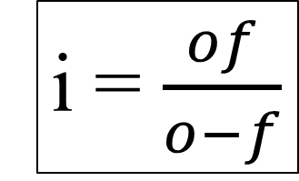
Why is the Calculation Wrong?
i = $\frac{of}{o−f}$
f | o | i | f*o | o-f
+5 | 5 | inf | 25 | 0
+5 | -5 | 2.5 | -25 | -10
Both o*f and o-f are wrong when o<0,
Need to modify the equation

Slide 6
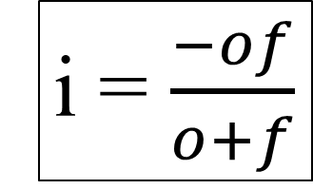
Correct When o<0
i = $\frac{−of}{o+f}$
f | o | i | f*o | o-f
+5 | 5 | -2.5 | -25 | 10
+5 | -5 | inf | -25 | 0
New equation satisfies correct for o<0,
But wrong for o<0….

Slide 7
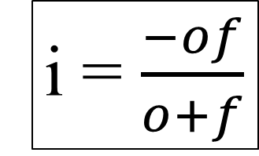
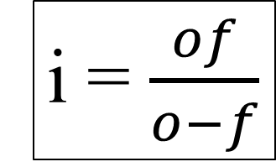
Must Satisfy both Object Positions
When o<0, use:
When o>0, use:
i = $\frac{−of}{o+f}$
i = $\frac{of}{o−f}$
→Draw the UML

Slide 8
If (Conditional Flow)
o>0
if(o>0){
i = o*f/(o-f);
}else{
i = -o*f/(o+f);
}
i=-of/(o+f)
i=of/(o-f)
o>0 → program executes the upper equation, otherwise(o<=0) → execute thelower equation.

Slide 9
Modify Code
o>0
i=-of/(o+f)
i=of/(o-f)
if (a<b){
c=a;
}else{
c=b;
}
→ Modify Code,i.e., equLens()

Slide 10
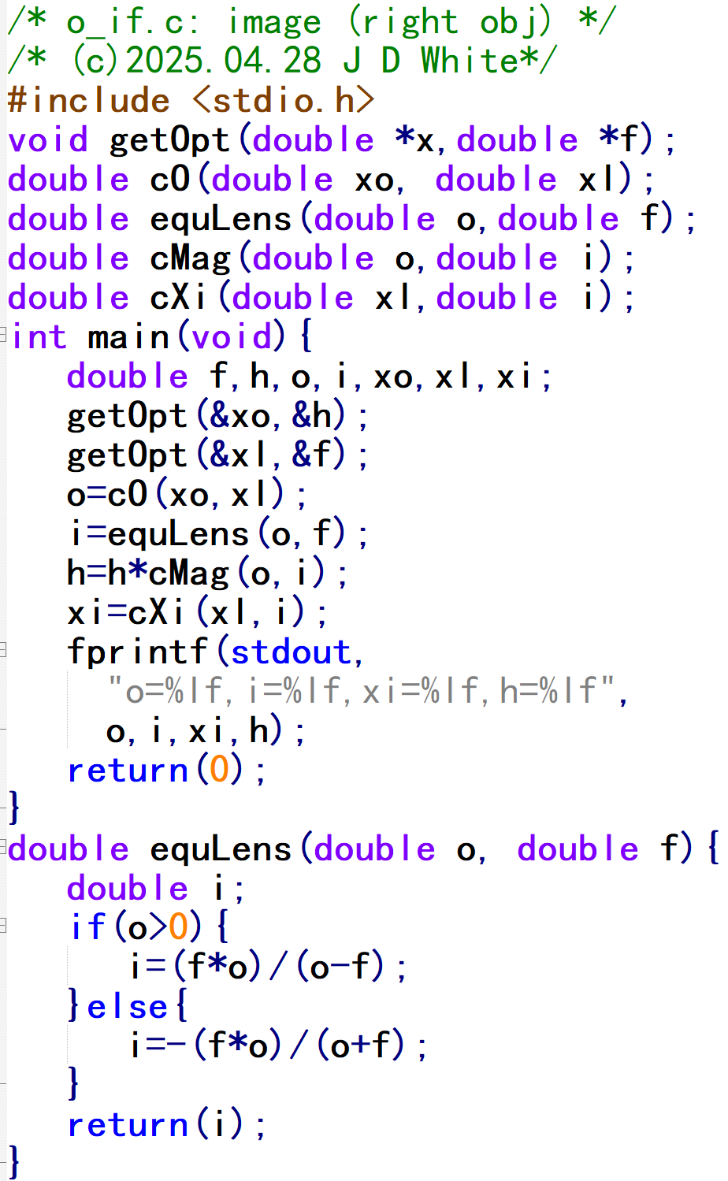
Modified Code

Slide 11
Run the Code
gcc –c –Wall -g xxx.c
gcc –o y.exe xxx.o
y
→ Run Code (gdb?)

Slide 12
Conditional Flow Analysis (Head)
Info for Human Reader
Info Pre-processor: Prototype Location
Function prototypes (this file)

Slide 13
Conditional Flow Analysis (Start)
main()
xi
xo
h
o
xl
i
f

Slide 14
Conditional Flow Analysis
equLens()
o
0.0e1
0.20e2
-0.10e2
f
-0.5e1
0.5e1
0.5e1
i
-0.10e2
0.10e2
-0.10e2
-0.10e2
0.5e1
getOpt()
cO()
cMag()
cXi()
o<0 → jump to else

Slide 15
Conditional Flow Analysis (End)
0.0e1
0.20e2
-0.5e1
-0.10e2
0.10e2
-0.10e2
0.5e1
fprintf()
o=-10.00000, i=-10.00000, xi=0.00000, h=-5.00000

