Slide 1
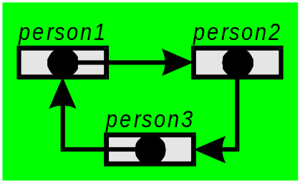
§6 Pointers 指標
Pre-Reading: Structuring Data and Building Algorithms §1.3.1

Slide 2
Outline
Why do we need? (Motivation)
What are they? (Ref. SDBA 1.3)
VP diagrams (Ref. SDBA 1.3)
Declaring, Initializing & Using (Ref. SDBA §1.3)
Pointers, Variables & Functions (Ref. SDBA §1.4)
Application (fscanf())
Misunderstandings
On to our problems…

Slide 3
Pointers Lesson 1
Worked Example M3: Function calls function calls function: e.g. Quadratic Equation Solution
Theory: Pointers and Addresses
Break (10’)
Theory: Pointers and Addresses
You Turn: Code & Observe
Break (10’)
Closing Discussion on Pointer
Retry Milestones 2 or 3
Go Home
General Concepts:
§4 Pointers pg 25

Slide 4
Pointers Lesson 2
Review: Pointers & Addresses
Theory: & Functions including I/O
Theory: Clarifying Misunderstandings
Break (10’)
Apply: Live Coding Demo: Falling Objects
Break (10’)
Apply Optics
  Your Turn
  Live Coding Demo
M4 VP Diagram Interpretation First Try + Retry
Go Home
Homework (Your Turn): Root Finding
§3 C-Code
(g_ptr.c) pg 31
§3 Simple Lens Formula
(o_ptr.c) pg 39
§3 Root Finding
(r_ptr.c) pg 51

Slide 5
Why do we need Pointers?
Our function can return only 1 piece of info
Nice to get two pieces of info at once
Examples
  Height (h) and time (t) for falling object
  Position (xl) & focal length (f) of lens
  minimum (xs) and maximum (xb) for root finder
double getFloatPrompt(char *);

Slide 6
Why do we need Pointers?
To do this need either to:
  tell function where to put data, or,
  have function tell us where it put data
→ exchange addresses
To do this requires pointers…

Slide 7
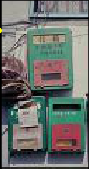
Why do we need Pointers?
Using variables (direct transfer, copy)
8
8
8
4
4
4
Using pointers (common box, original)
8
4
4
8

Slide 8

Objectives
In this module we will:
  Introduce the concept of a pointer
  Learn the VP diagram representation
  Declare and initialize pointers in ANSI-C
After this module you should be able to:
  Write the VP diagram for a pointer
  Use pointers in a simple program
  Choose the correct representation for a problem

Slide 9
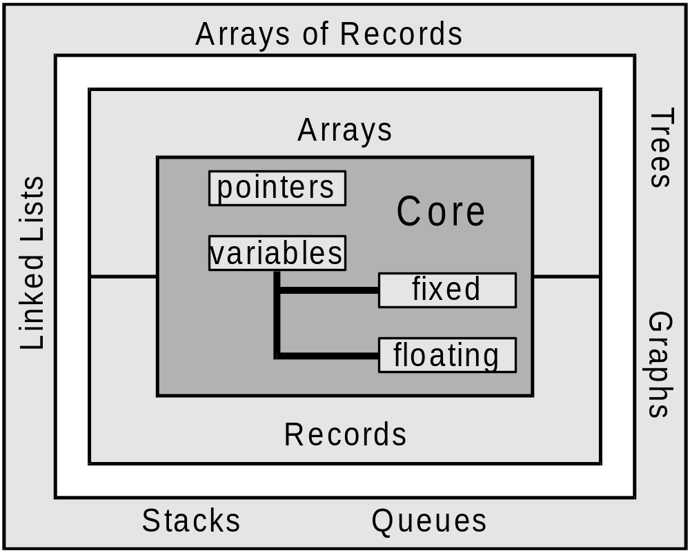
In Context…

Slide 10
Definition
A pointer is simply …
a memory location that contains
  an address of another memory location
  rather than a value (information).
variable
pointer
value
address

Slide 11
VP Diagram of a Pointer
name
(handle)
root
container
(memory)
dot

Slide 12
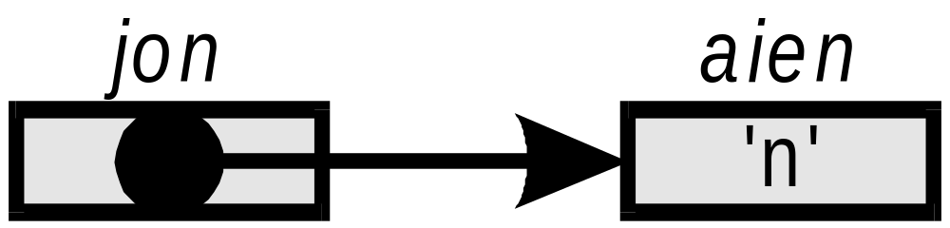
Pointer to a Variable
arrow

Slide 13


NULL Pointer
A NULL pointer points to address 0 which does not exist. (allows program debugging)
ground

Slide 14
This Module’s Code...as
Declares variables and pointers
Initializes variables and pointers
Prints each variable and pointer’s address
Prints the value stored at each memory location

Slide 15
(Preview) Questions
How do we visualize using a VP diagram?
What do “&” and “*” mean?
What are the steps in using variables & pointers?
How do we declare variables and pointers?
How do we initialize variables and pointers?
What does “**” mean?
Can we write “&&”?
How is memory allocated?
Where would I need to use pointers?
.1

Slide 16
varPtr.c
0
/* varPtr.c : demonstrate pointers and variables */
0
/* (c)2001 J. D. White */
1
#include <stdio.h>
2
3
int main(void){
4
long fred, ahmad;
Variable declarations
5
long jim=3;
6
long *zarina;
7
long *husna=&ahmad;
Pointer declarations
8
long **pohli;
9
10
fred=1;
Variable initialization
11
ahmad=
2;
12
.1
zarina=&fred;
Pointer initialization
fixed-point
13
pohli=&zarina;
(int) format
14
15
fprintf(stdout,“Name Add Contents\n”);
16
fprintf(stdout,“fred %p\t%ld\n”,&fred,fred);
17
fprintf(stdout,“ahmad %p\t%ld\n”,&ahmad,ahmad);
18
fprintf(stdout,“jim %p\t%ld\n”,&jim,jim);
19
fprintf(stdout,“zarina %p\t%p\n”,&z
arina,zarina);
20
fprintf(stdout,“husna %p\t%p\n”,&husna,husna);
21
fprintf(stdout,“pohli %p\t%p\n”,&pohli,pohli);
22
return(0);
23
}
address
‘&’ prints
prints contents of
format
memory location
memory location

Slide 17
varPtr.c (Output)
Adruino (16 bit)
Name Add Contents
fred FFF4
1
What is stored at this lo
cation
ahmad FFF2
2
jim FFF0
3
Address of memory location with given name
zarina FFEE
FFF4
husna FFEC
FFF2
Note: a pointer holds the
pohli FFEA
FFEE
address to which it is pointing
MS-Windows (64 bit)
Name Address Contents
fred 0061FF1C
1
ahmad 0061FF18
2
jim 0061FF14
3
zarina 0061FF10 0061FF1C
husna 0061FF0C 0061FF18
pohli 0061FF08 0061FF10
S

Slide 18
Questions
How do we visualize using a VP diagram?
What do “&” and “*” mean?
What are the steps in using variables & pointers?
How do we declare pointers?
How do we initialize pointers?
What does “**” mean?
Can we write “&&”?
How is memory allocated?
Where would I need to use pointers?

Slide 19
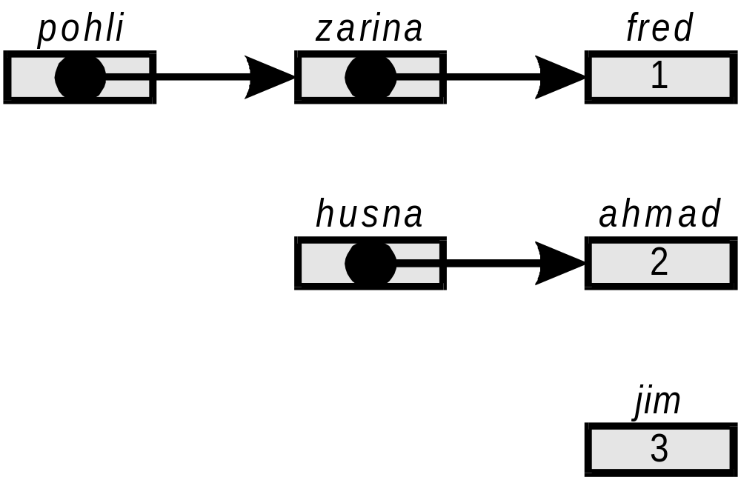



How Can We Visualize Using a VP Diagram?
long fred, ahmad;
long jim=3;
long *zarina;
long *husna=&ahmad;
long **pohli;
fred=1;
ahmad=2;
zarina=&fred;
pohli=&zarina;

Slide 20
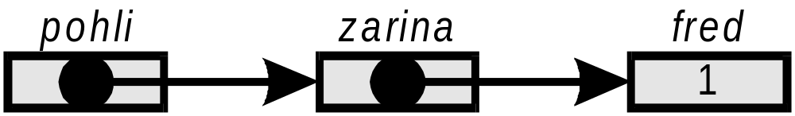
What Does “&” Mean?
& returns the address (memory location) occupied by a variable or pointer
Eg. zarina = &fred;
  Returns the address of fred, and,
  Places it in the pointer container zarina
  Read:
    “the address of fred is placed in zarina”
    zarina points to fred

Slide 21
Denotes a pointer being declared
Eg. long *zarina;
Declares zarina will point to a variable of type long

Slide 22
Returns the contents of a memory location pointed to by a pointer
Eg: fprintf(stdout,“%ld\n”,*zarina); returns the contents of memory location pointed to by zarina, i.e. the contents of fred) and prints it.
Read: “dereference zarina”

Slide 23
What are the Steps in Using
Variables & Pointers?
Declare
Initialize
Use
You cannot initialize before declaration
You should not use before initialization.
If you Declare and Initialize you should use!
ERROR
WARNING
WARNING

Slide 24
How Do I Declare?
type
pointer
indicator
name
(handle)
long
*ptr, var;
name
(handle)

Slide 25
Allowable Types
Fixed: int, char, short, long
User defined
type *name1, name2;
Floating: float, double

Slide 26
How Do I Initialize?

Slide 27
How Do I Initialize?
fred=1;
zarina=&fred;
Name Add Contents
fred FFF4
1
zarina FFEE
FFF4

Slide 28
How Do I Initialize?
long jim=3;
long *husna=&ahmad;
Name Add Contents
ahmad FFF2
2
jim FFF0
3
husna FFEC
FFF2

Slide 29
How Do I Initialize?
long *husna=&ahmad;
long *husna;
husna=&ahmad;
Name Add Contents
ahmad FFF2
2
jim FFF0
3
husna FFEC
FFF2

Slide 30
Null Initialization
long fazli=0;
long *azura=NULL;
Name Add Contents
fazli FFF2
0
azura FFEC
0000
A pointer pointing randomly is dangerous It may actually be pointing at the OS!
þ
þ
Initialize all variables!
Initialize all pointers!

Slide 31
What Does “**” Mean?
within
declaration
2 different
meanings
elsewhere
Declares a pointer to a pointer
Eg. long **pohli;
Declares that pohli will point to a pointer that points to an int. (2 arrows separate pohli from a value)
pohli may point to zarina
pohli may not point to fred

Slide 32
What Does “**” Mean?
within
declaration
2 different
meanings
elsewhere
fprintf(stdout,“%d\n”,**pohli);
Name Add Contents
fred FFF4
1
zarina FFEE
FFF4
pohli FFEA
FFEE

Slide 33
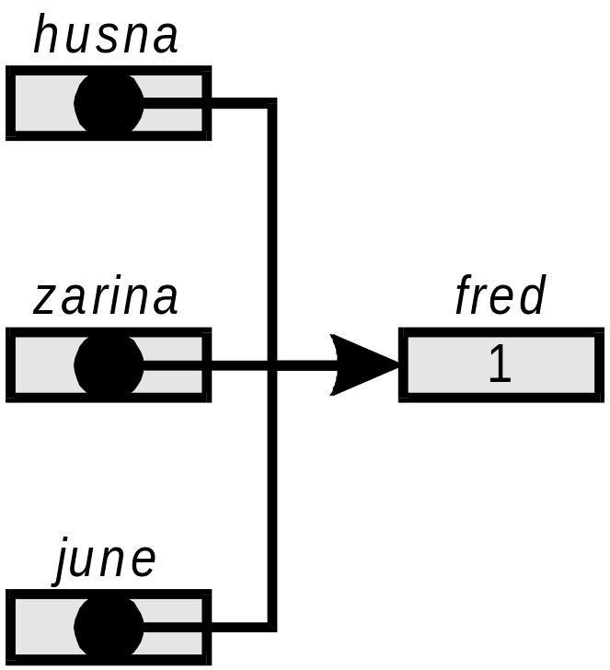
Can We Write “&&”?
This is not defined.
While the address of fred is unique (&fred),
&&fred could be husna, zarina, or june
NO!

Slide 34
How is Memory Allocated?
Compiler has allocated memory contiguously
In this example,
  int uses 2 bytes (16 bits)
  pointers use 2 bytes (16 bits)
The length of int and pointers depends on the compiler, though those that follow the modern standard use 4 bytes (32 bits).
Note that order is not related to order declared
Name Add Contents
fred FFF4
1
ahmad FFF2
2
jim FFF0
3
zarina FFEE
FFF4
husna FFEC
FFF2
pohli FFEA
FFEE

Slide 35
Where Would I Need Pointers?
In Functions: When you want to modify the value contained in a variable in a function called by the main program.
  Pass the variable's address to function
  Need a pointer in the function to hold the address
In implementing other data structures
See examples in the next modules….

Slide 36
Triplet Discussion Point (1/3)
Is int ***rachel; a valid declaration?
If so, to what may rachel point?
Yes
pohli

Slide 37
Triplet Discussion Point (2/3)
What do these statements print?
  fprintf(stdout,"%p",&rachel);
  fprintf(stdout,“%p”,rachel);
  fprintf(stdout,“%p”,*rachel);
  fprintf(stdout,“%p”,**rachel);
  fprintf(stdout,“%p”,***rachel);
(Windows 32 bit)
name Addre Conte
rachel 8f740 8f744
pohli 8f744 8f748
zarina 8f748 8f74c
fred 8f74c 1
pohli
zarina
fred
fred
1
&rachel 8f740
&pohli 8f744
&zarina 8f748
&fred 8f74c
fred’s contents 1
1
rachel

Slide 38
Triplet Discussion Point (3/3)
pohli
zarina
fred
fred
1
1
1 /* 13ptr1q.c : triple pointers*/
2 /* 2014 J D White */
3 #include <stdio.h>
4 int main(void){
5 long fred=1;
6 long *zarina=&fred;
7 long **pohli=&zarina;
8 long ***rachel=&pohli;
9 fprintf(stdout,"name Addre Conte\n");
10 fprintf(stdout,"fred %5p %5p\n",&fred, fred);
11 fprintf(stdout,"zarina %5p %5p\n",&zarina, zarina);
12 fprintf(stdout,"pohli %5p %5p\n",&pohli , pohli);
13 fprintf(stdout,"rachel %5p %5p\n",&rachel, rachel);
14 return(0);
15 }
name Addre Conte
rachel 8f740 8f744
pohli 8f744 8f748
zarina 8f748 8f74c
fred 8f74c 1
rachel

Slide 39
Summary
Contents
  Variables hold values
  Pointers hold addresses
Declaration:
  Variables: type name;
  Pointers: type *name;
Both should be initialized at least to zero
  type name=0;
  type *name=NULL;
變數內的值
指標指向的位置
變數宣告: type name;
指標宣告: type *name;
所有變數及指標都初始值必須被定義為零
  type name=0;
  type *name=NULL;

Slide 40
目標
在這個單元我們將學習:
  介紹指標的概念
  學習VP圖示表示法
  在ANSI-C規範下，定義及初始化指標
在這個單元之後你將學習到:
  會寫VP圖指標器
  在簡單的程式下使用指標器
  對一個問題能正確的描述

Slide 41
Optional Discussion…
*& - &*

Slide 42
Check Your Comprehension
Open work book: General Concepts §4 (pg. 25)
Complete the questions
(Use a computer program to check for the errors)
Ask the facilitator or a tutor about anything that is confusing.
When you are complete, have the TA stamp.

Slide 43
Pointers, Addresses & Functions
Pre-Reading: Structuring Data and Building Algorithms §1.4
Link to 6sdba14vpfunc

Slide 44
Input and Output
Pointers and Variables
Input Use Pointers (pass Addresses)
Output Use Variables (pass Values)

Slide 46
Questions
What is the format of fscanf()?
Can we get information without using pointers?
How do fprintf() & fscanf() work?

Slide 47
What is the format of fscanf()?
fscanf(stdin,“%lf”, &x);
Where to put it?
Standard C
function to input data
(stdio.h)
What type of data?
1 double
Where do I get the data?
long
floating
stdin→ standard input device
(on PC, by default your keyboard)

Slide 48
Can we get info without Pointers?

Slide 49
fscanf()
6
main()
x
%lf
0.60e1
fprintf()
6.0000
%lf
0.60e1

Slide 50
fscanf()
6
main()
x
%lf
0.60e1
%.0lf
fprintf()
6.
%.0lf
0.60e1

Slide 51

Clarifying
Misunderstandings

Slide 52
Equations in Math
Math
2+2
5
Y+2
= 4
= X + 5
= 2
Not in Programming!
In math: LS=RS
In Programming:
LS is a container
RS is a value

Slide 53
Math: Solving Equations
Math
X =
Y =
∴ X =
X =
Y =
Y + 1 (1)
2X – 3 (2)
2X – 2 (sub 2 in 1)
2 (solve for x)
-1 (solve for y)
Not in Programming!
In programming….
if y=4→
X = 5 (after 1)
Y = 7 (after 2)
In programming….
if y=0→
X = +1 (after 1)
Y = -1 (after 2)

Slide 54
Computer Science
Container Contents
ptr =
X =
Y =
*ptr =
address or number
&X
9
2
4*Y + 1
ptr
X
9
Y
2
X = X;
*ptr = *ptr;
Container
Name
Container
Contents

Slide 55
Logical Connections
Logic
Cup
Box
Balloon
Water
Toilet paper
Air
Water
Toilet paper
Air
Cup
Box
Balloon
Logic
Programming

