Slide 1
Program Flow:
Sequence, Decision, Repetition
What are the 3 constructs? (Review)
Why do we need them? (Motivation)
How do we implement them in C?
Apply to our Three Problems

Slide 2
Flow Lesson 1
Take-Up M3: Problem → UML → C
Worked Example VP :
Break (10’)
Take Up: Pointers in Root Equation
Theory: Review (UML) of Flow Constructs
Theory: Implementation of Conditions in C
Together: Correct Optics Code
Break (10’)
Together: Correcting Optics Code
Retry Milestones 2 or 3 or 4
Go Home
General Concepts §5 Pointers pg 16
Optics: §4 Pointers pg 42

Slide 3
Flow Lesson 2
Take-up M4: Code Analysis with VP diagrams
Review: Flow
Break (10’)
Using Multiple Files for Code: Optics
Theory: Implementation of Repetition in C
Break (10’)
Together: Optics
Retry Milestones 2 or 3 or 4, Try MS-5
Go Home
Homework: Add repetition to Falling Objects
Optics: §5 Loop pg xx
Optics: §5 Loop pg xx
Gravity: §5 Loop pg xx

Slide 4
Flow Lesson 3
Take-up M4: Code Analysis with VP diagrams
Review: Flow
Break (10’)
Take-up Homework: Repetition in gravity, file input
You Try: Decision + Repetition to root
Break (10’)
Take-Up: Decision + Repetition to Root
Retry Milestones 2 or 3 or 4, Try MS-5
Go Home
Homework: Reading Assignment
General Concepts §5 Pointers pg 16
Root: §5 Loop pg xx

Slide 5
Program Flow:
Sequence, Decision, Repetition
Review UML

Slide 6
Review: 3 Constructs for Algorithms
Sequence (Linear)
Decision (Conditional)
Repetition (loops)
Parallel (Later Course)

Slide 7
Sequence
Function runs from start to end
Each line executes once
(all our programs, so far have been this way)

Slide 8
Decision (Conditional)
Function starts to run
Based on the data,
  Only part of the function used
  Other part is not used

Slide 9
Repetition (Loops)
Function starts to run
Each line executed many times
e.g.:
  Ox,
  2x,
  20x,
  10000000x

Slide 10
Review: 3 Constructs Summary

Slide 11
Program Flow:
Sequence, Decision, Repetition
Why do we need?

Slide 12
Why do we need Sequence?
To carry out tasks
To do calculations
To call functions
y = 0;
Print y

Slide 13
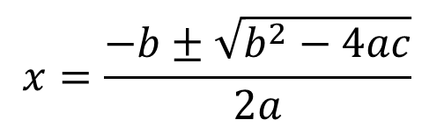
Why do We Need Decision?
Root finding for a Quadratic Equation
If d = b²- 4ac < 0 → change the sign before taking the square root
Optics Code: Problem if object on right side of lens.
y = ax² + bx + c =0
b²- 4ac < 0
$$x=\frac{−b±\sqrt{b^{2}−4ac}}{2a}$$
d = 4ac- b²
d = b²- 4ac

Slide 14
Why do we need Repetition?
Optics: Multiple lens
Falling objects: loop to read all data from a file & calculate without restarting the program
Root Finder: Find root automatically, rather than user entering guesses.

Slide 15
Program Flow:
Sequence, Decision, Repetition
How Do we Code?

Slide 16
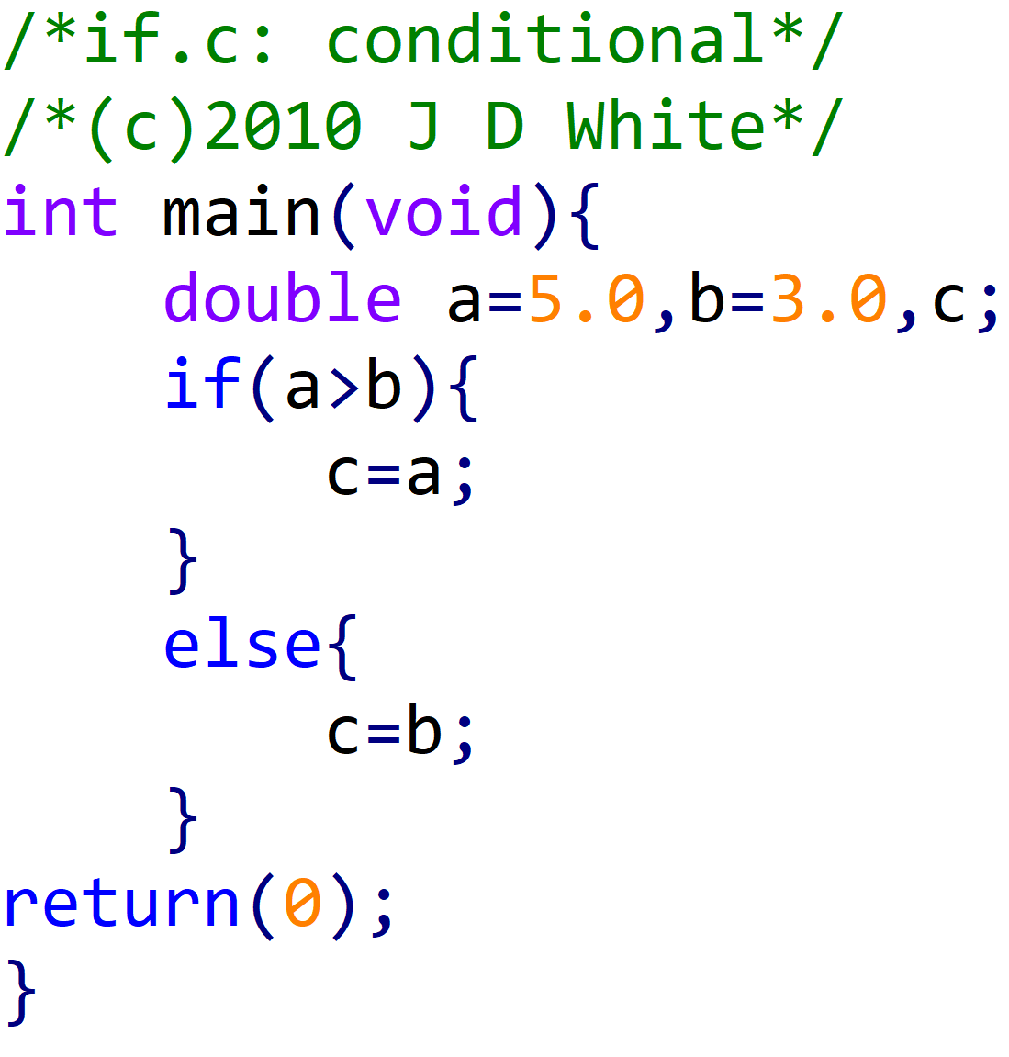
How do we code decision?

Slide 17
Decision Code Analysis
main()
a
0.50e1
b
0.30e1
c
0.50e1
a>b
c=b
c=a

Slide 18
Questions about Decision
What is the decision format?
What conditions can we test?
How do we handle multiple simultaneous conditions?
What about multiple paths?

Slide 19
What is the format of decision?
if(condition){
statement to execute if true;
statement to execute if true;
}else{
statement to execute if false;
statement to execute if false;
}
! Condition: must be TRUE/FALSE question

Slide 20
What conditions can we test?
(a == b)
(b != a)
=
(a < b)
(b >= a)
=
(a > b)
(b <= a)
=
=
!
A single ‘=’ means put the value on the right into the container on the left, e.g.,
a=b; would put the value in ‘b’ into container ‘a’

Slide 21
How to handle multiple conditions?
and
&&
||
!
or
not
if ( (a<b) && (b<c) ) {
if ( (a<b) || (b<c) ) {
English Note:
& Ampersand
| Pipe
! Exclamation Mark
if ( !(a<b) ) {
a>=b

Slide 22
What about multiple paths?
Act a
Act b
Act c

Slide 23
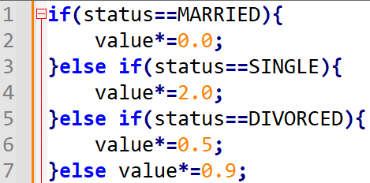
What about multiple paths?

Slide 24
What about multiple paths?
if(condition 1){
statement to execute if 1 true;
statement to execute if 1 true;
}else if(condition 2){
statement to execute if 2 true;
statement to execute if 2 true;
}else {
statement to execute ALL false;
statement to execute ALL false;
}

Slide 25
What about multiple paths? (switch)
!
Switch has only limited usage. You do not need to ever use it. But you should know it if you see in other’s codes
switch(condition){
case result A:
execute if match;
break;
case result B:
execute if match;
break;
default:
execute if no matches;
}

Slide 26
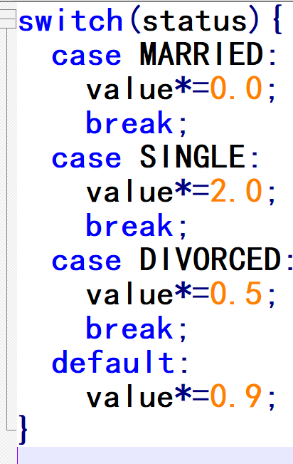
What about multiple paths? (switch)

Slide 27
Apply Decision to Optics (Lens)
Discover the error
Fix Gauss’ Lens Equation
Self Study: Pause These VGs and first solve Optics Code Problem

Slide 28
How do we code repetition?
Three choices for loops
While
For
Do-While

Slide 29
Repetition
What is the format of “while”?
What is the format of “for”?
Is “for” or “while” better?
Which is faster?
Can I test at the end of a loop?
Can I test in the middle?

Slide 30
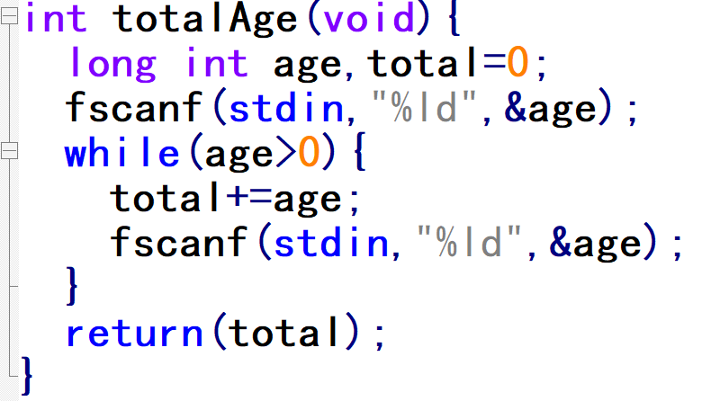
What is the format of “while”?
Read age
Total=0;
while(condition){
statement to execute;
statement to execute;
}
age>0
total+=age;
Read age.
total = total + age;

Slide 31
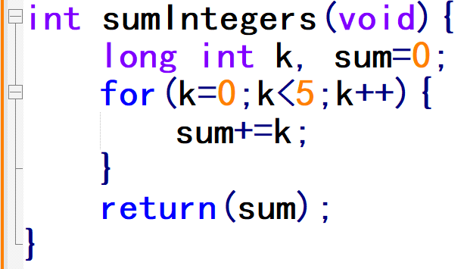
What is the format of “for”?
sum=0;
k=0;
for (initialize; condition; increment){
statement to execute;
statement to execute;
}
k<5
sum+=k;
k++;

Slide 32
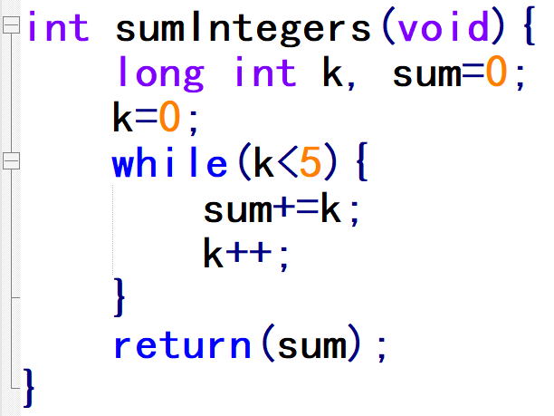
Q3. Is it better to use “for” or “while”?
Depends on Problem
if(number of loops known){
use a “for” loop;
}else{
use a “while” loop;
}

Slide 33
Is it better to use “for” or “while”?
Know how
many loops
yes
while
for

Slide 34
“for” or “while”? Which is Faster?
No difference (OC same)!
SDBA §7.3
VP OC counts

Slide 35
Can I test at the end of a loop?
Test Before
Test After

Slide 36
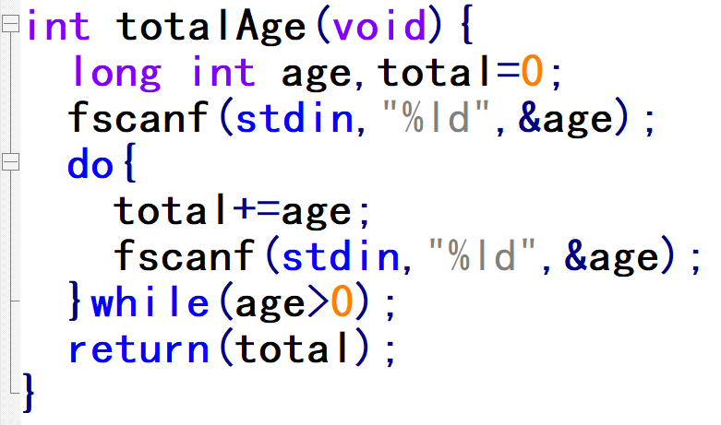
Can I test at the end of a loop?
Test Before
Test After

Slide 37
Q5. How can I test at the end of a loop?
do{
statements to execute;
statements to execute;
}while(condition);

Slide 38
Can I test in Middle of Loop?
YES but…
Test Before
!
Not Good, i.e., HORRIBLE
Programming Style!
(Analogy) You want a new phone:
You can first pay for the phone ($$$)
You can pay later (Signed Contract)
Make off with the phone (steal)
Make out with the shop owner
Test After

Slide 39
Repetition Summary
# loops fixed # loops depend on data
!

Slide 40
Apply Repetition to Optics
Multiple Lens case
For example, i-phone 6…
  3 cameras
  each camera being proceeded by a series of 6 or 7 lens.
  21 lens elements to optimize

Slide 41
Apply Repetition to Falling Object

Slide 42
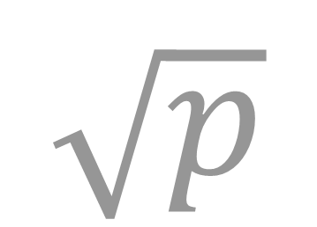
Apply Repetition + Decision → Root
$$\sqrt{p}$$

Slide 43
Reminder: CS = is not Math =
Left Side = Right Side in CS means…
  Calculate the value on the right side
  Put it into the container referenced on the left side.
E.g.
  fred = 6; place the value of 6 into the memory location (container) named Fred.
  fred = susan; Take the value that is stored in the container named susan and place a copy in the container named fred.
  fred = Fred + 5; take value that is stored in the container named Fred, add 5 to it and put the result back into the container Fred.
Remember:
  Left Side is the container
  Right Side is the contents

