Slide 1
XTOP-2024 Awards Ceremony
2024

Slide 2
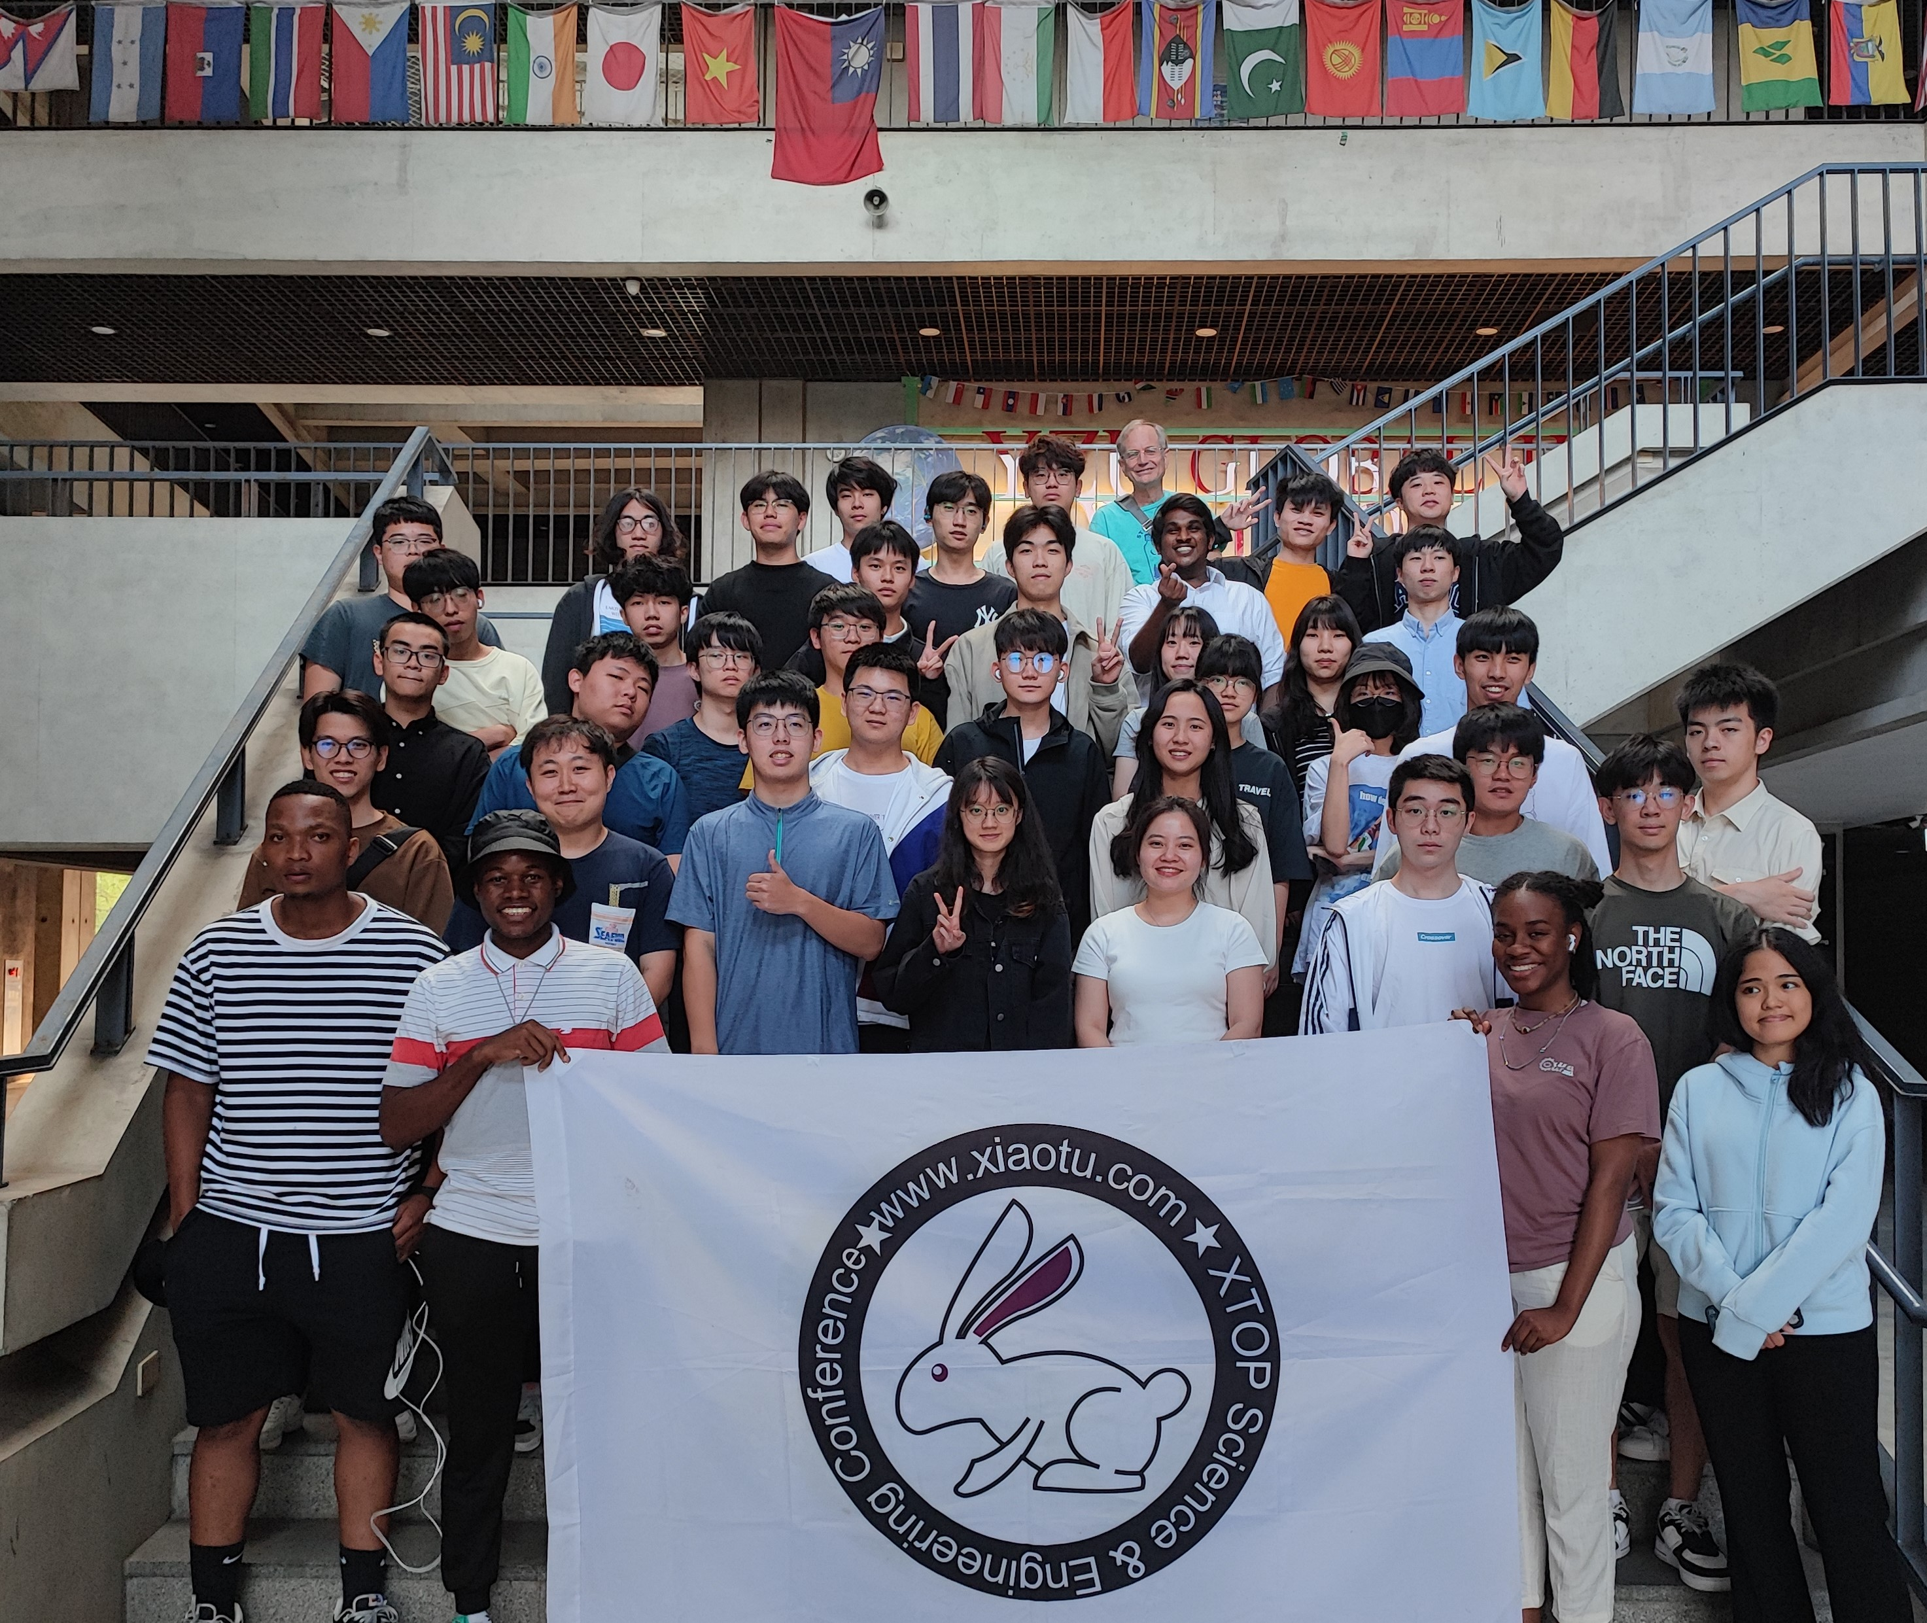

Slide 3
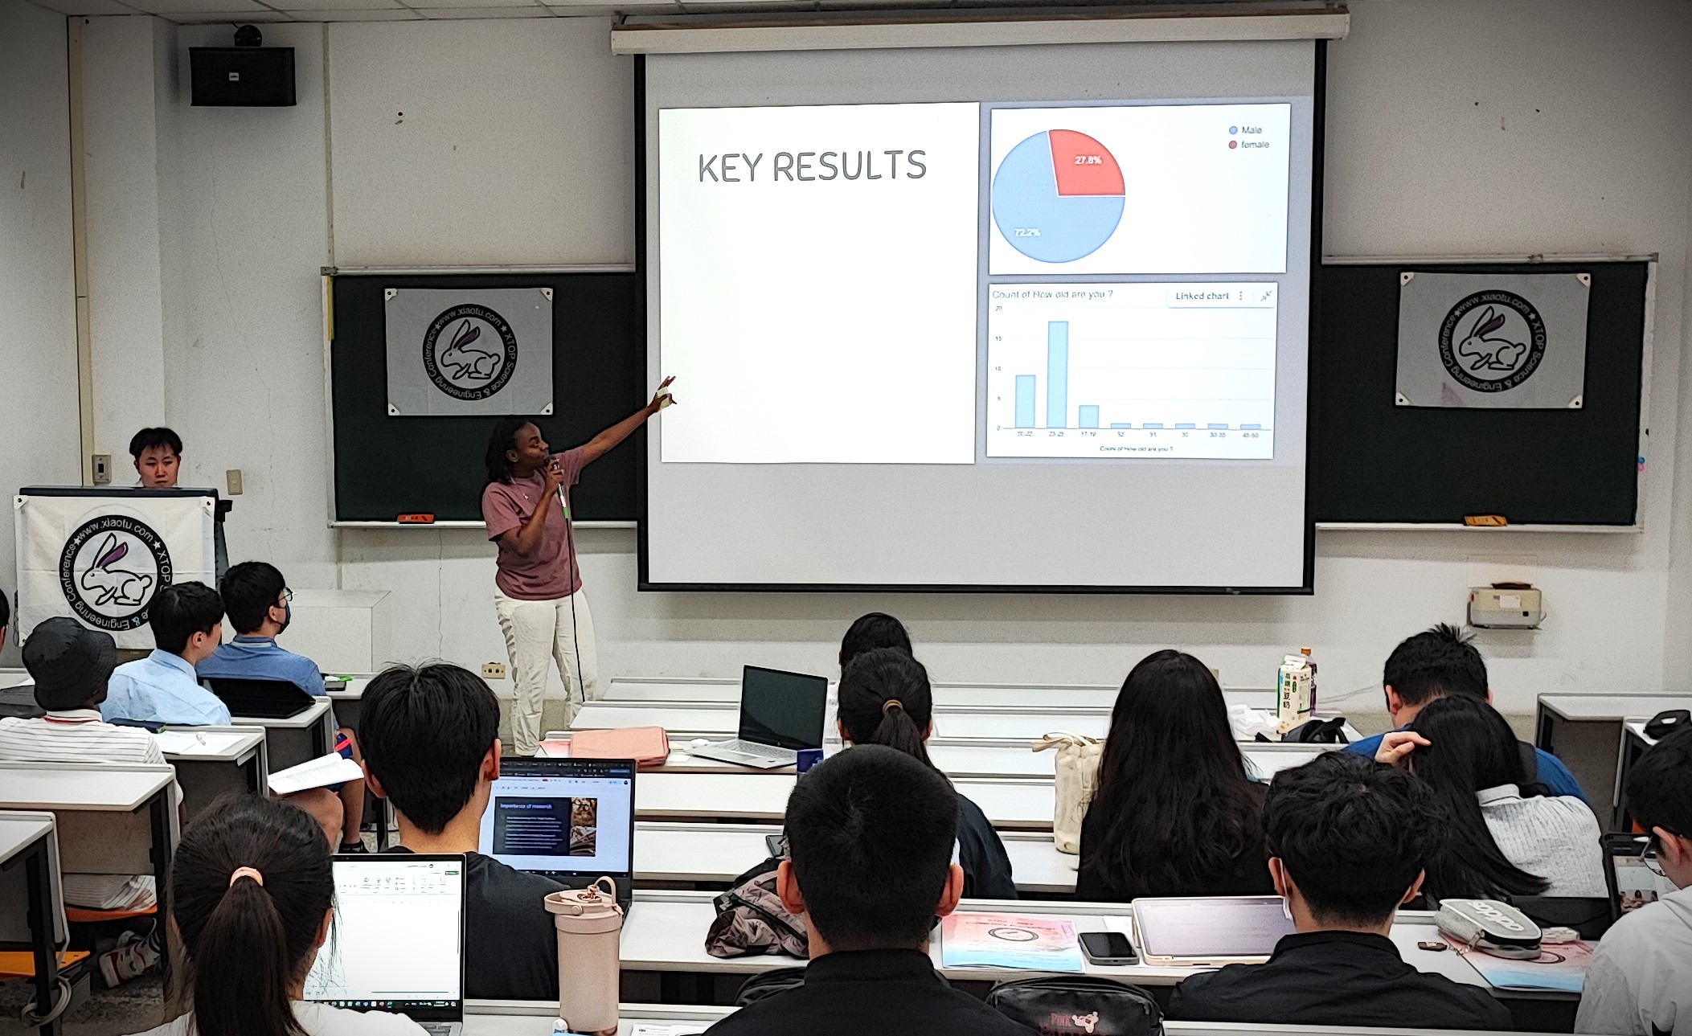

Slide 4


Appropriate Response
https://oooh.tv/
https://www.supercoolheckyeah.com/product/ahhhhh-sticker/

Slide 5
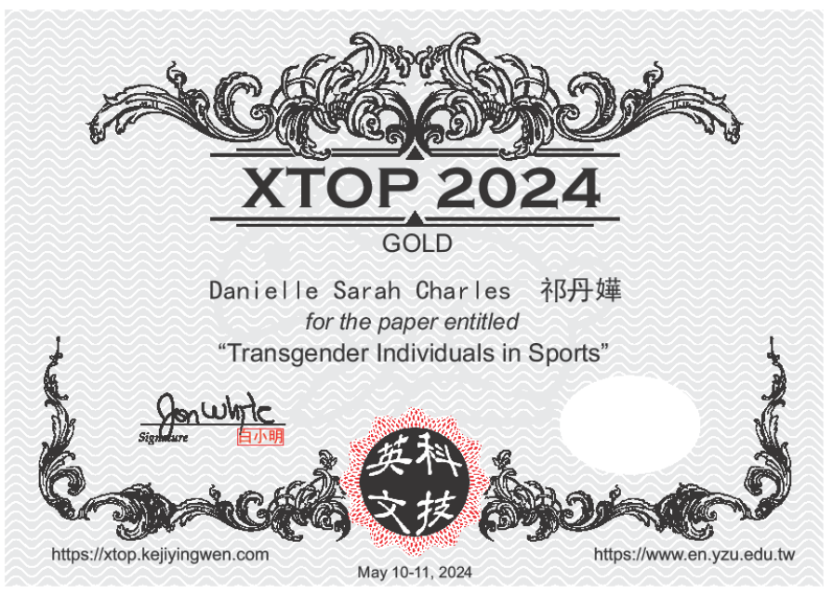
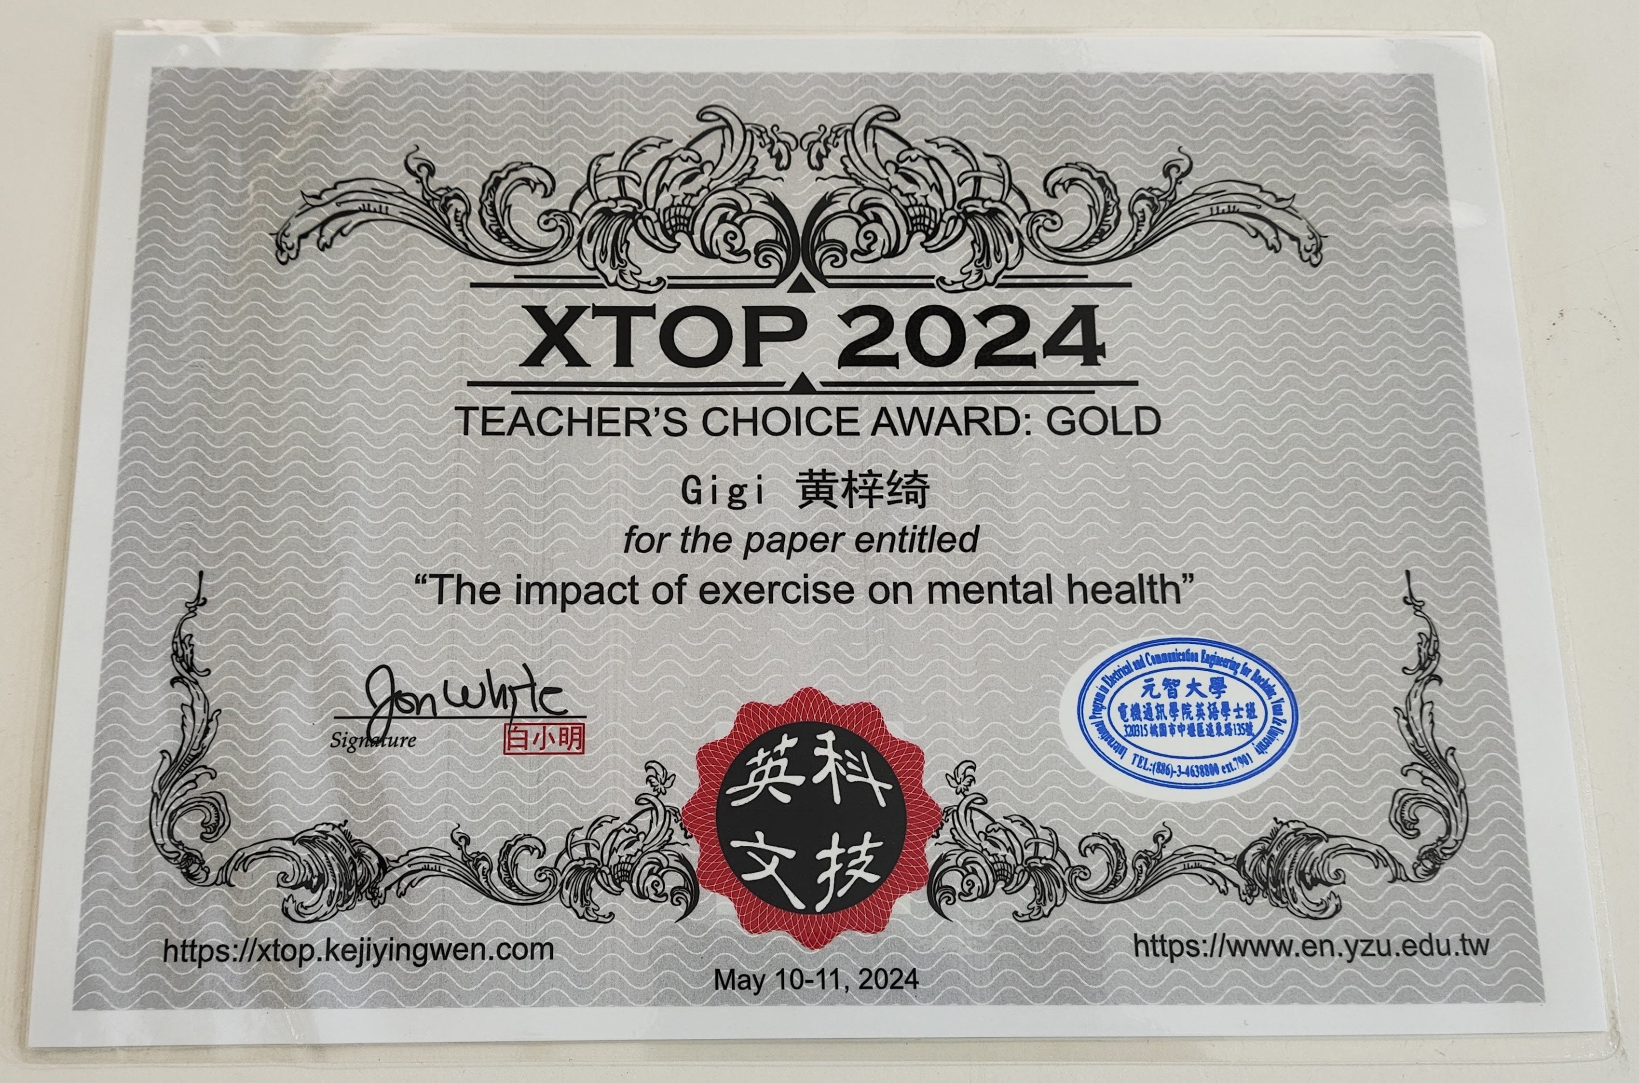
A Beautiful Certificate for Your CV

Slide 6
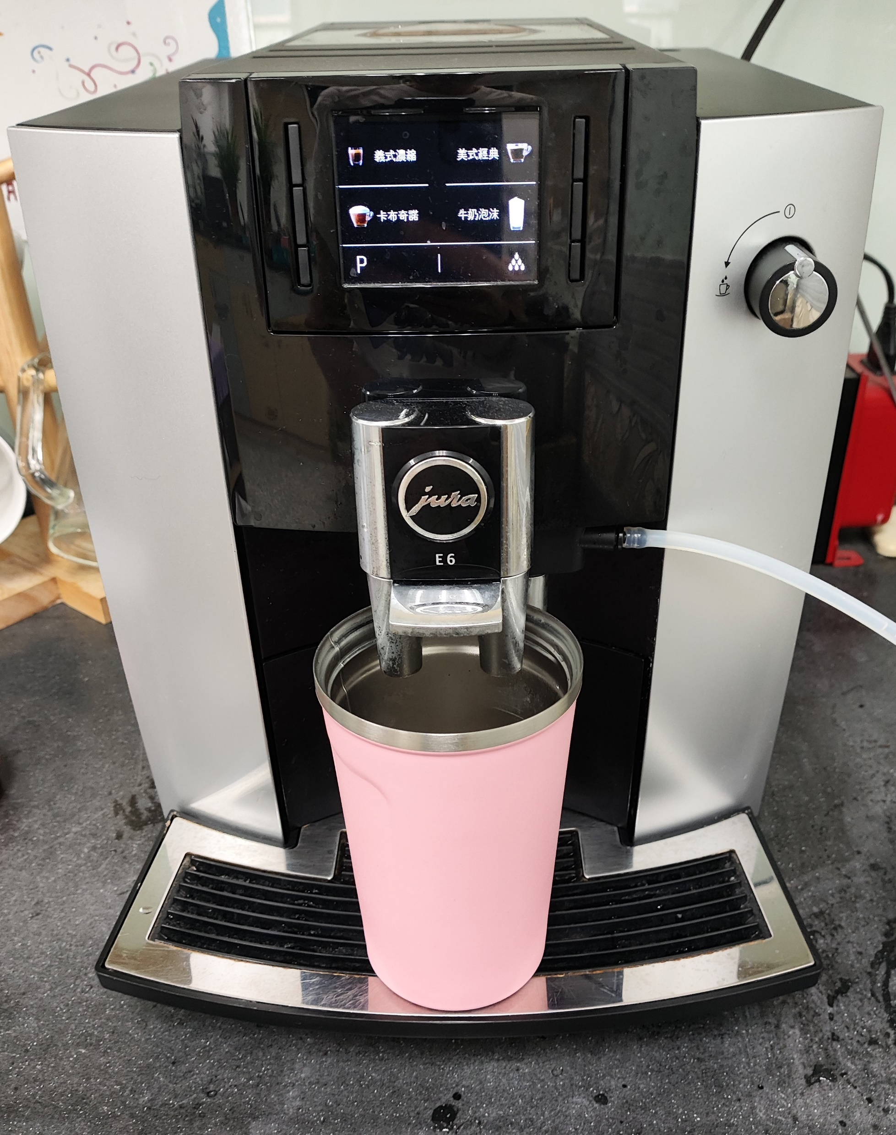

+ Beautiful Pink Vacuum Cup

Slide 7
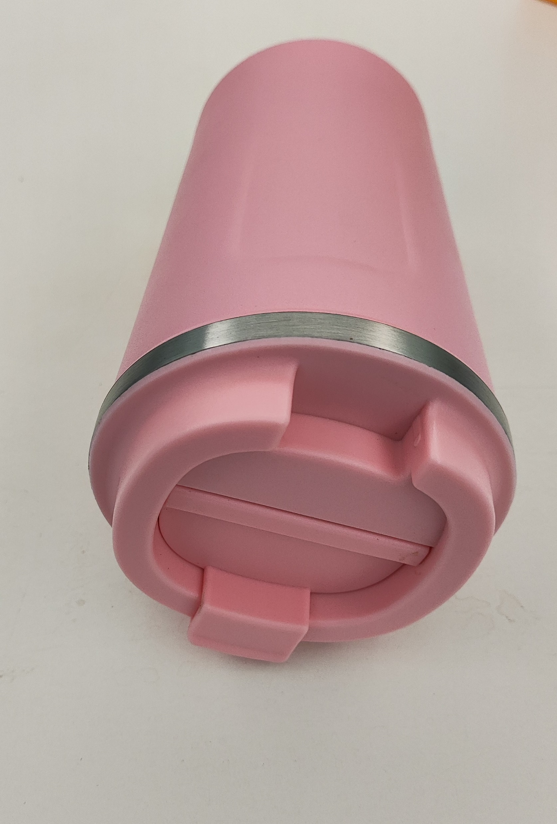
…that does not spill or leak!

Slide 8
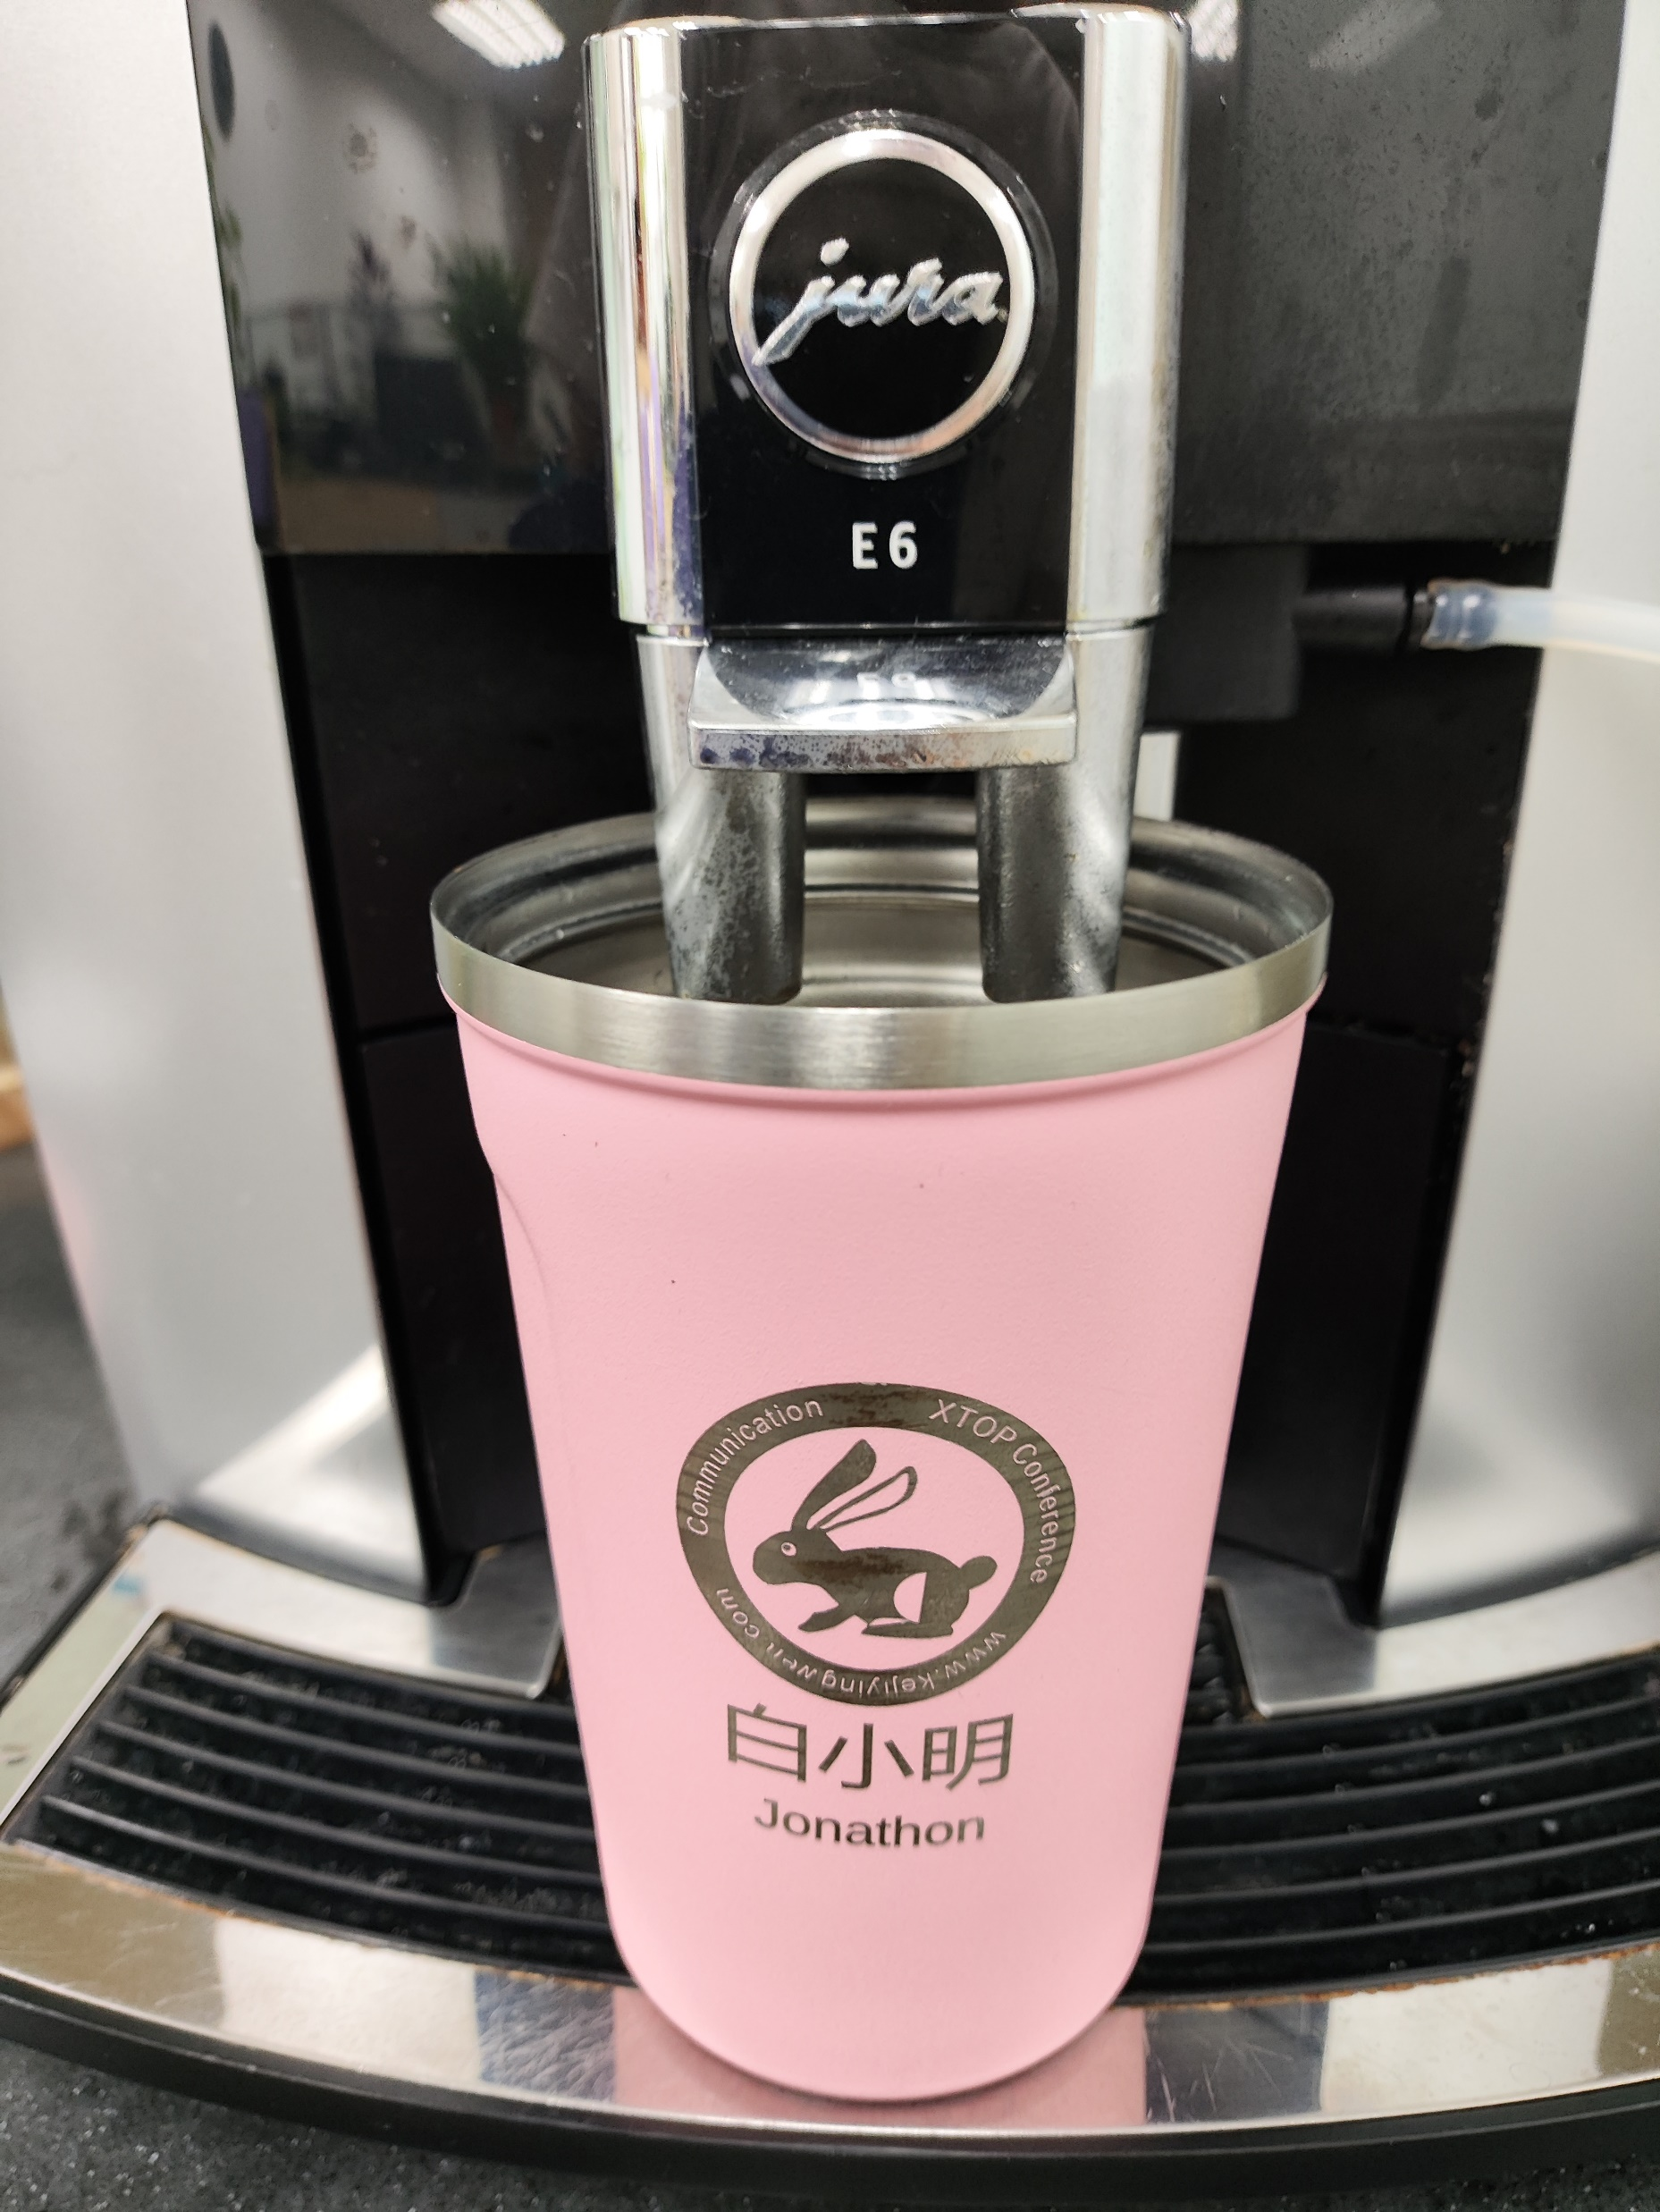

…and is personalized！

Slide 9
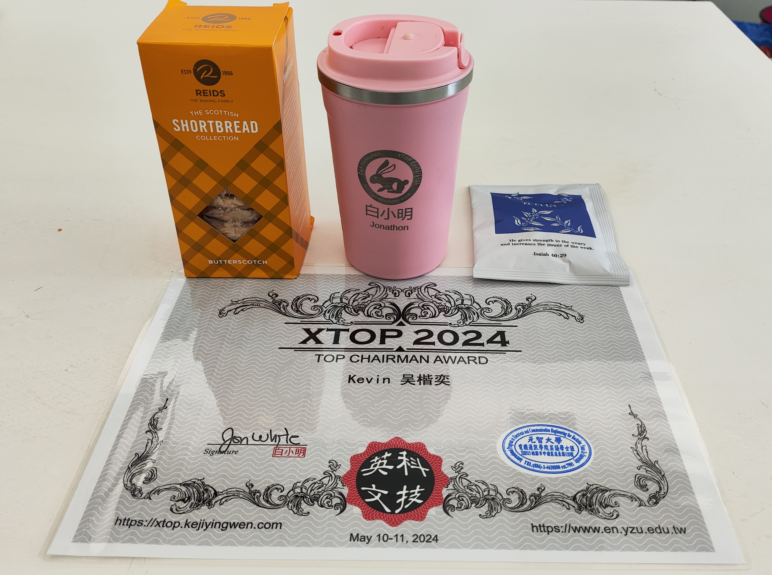
w/ Scottish Shortbread & Premium Coffee

Slide 10
Congratulations
Students’ Choice Award
Teacher’s Choice Award
Gold: Danielle Sarah Charles
Silver: John Edwin Ong Yang
Bronze:
  Junior
  Stella
Best Scientific Presentation: Gigi
Top Chair: Kevin

Slide 11
Congratulations to All for Marking
Student’s Mark
Teacher’s Mark
Mean µ = 33
Std Deviation σ = 13.3
Mean µ = 32
Std Deviation σ = 13.3
Thank you…

